Slide 1
Template
Introduction to Restorative Justice Diversion
TEMPLATE // INTRODUCTION TO RESTORATIVE JUSTICE DIVERSION
BY THE RESTORATIVE JUSTICE PROJECT AT IMPACT JUSTICE // RJDTOOLKIT.ORG
This work is licensed under the Creative Commons Attribution-NonCommercial 4.0 International License.
To view a copy of this license, visit creativecommons.org/licenses/by-nc/4.0.
Notes:
This is a template for a RJD 101 presentation. Feel free to edit these slides and personalize them however you’d like so that it matches your organization’s aesthetics. As you’re editing the slides, can remove this first one as well as the footer on each slide.

Slide 2
Introduction to Restorative Justice Diversion
TEMPLATE // INTRODUCTION TO RESTORATIVE JUSTICE DIVERSION
BY THE RESTORATIVE JUSTICE PROJECT AT IMPACT JUSTICE // RJDTOOLKIT.ORG
Notes:
Introduce yourself:
Who are you?
What organization (if any) are you with and give a brief overview of your org
What is your role?
Why are you here?
TIP: feel free to add your names, organization logos, etc. to this page! This entire powerpoint is intended to be a useful template and guide, but we strongly encourage you to make it your own—add your own flavor, pictures, words, etc. to this so that it feels representative of who you are as an organization and how RJD will fit into your community!

Slide 3
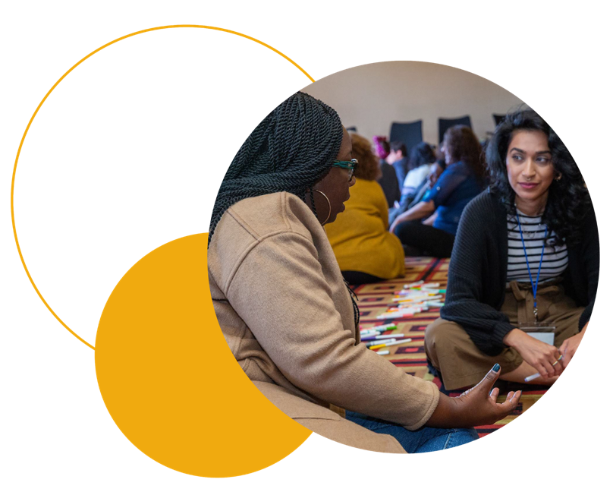
Who’s in the Room?
Name and pronouns
Role and department
One sentence on your experience with/prior knowledge of restorative justice
TEMPLATE // INTRODUCTION TO RESTORATIVE JUSTICE DIVERSION
BY THE RESTORATIVE JUSTICE PROJECT AT IMPACT JUSTICE // RJDTOOLKIT.ORG
Notes:
Check-in. Get to know who’s in the room.
TIP: Click HERE for more information on why it’s important to include pronouns in meeting introductions!

Slide 4
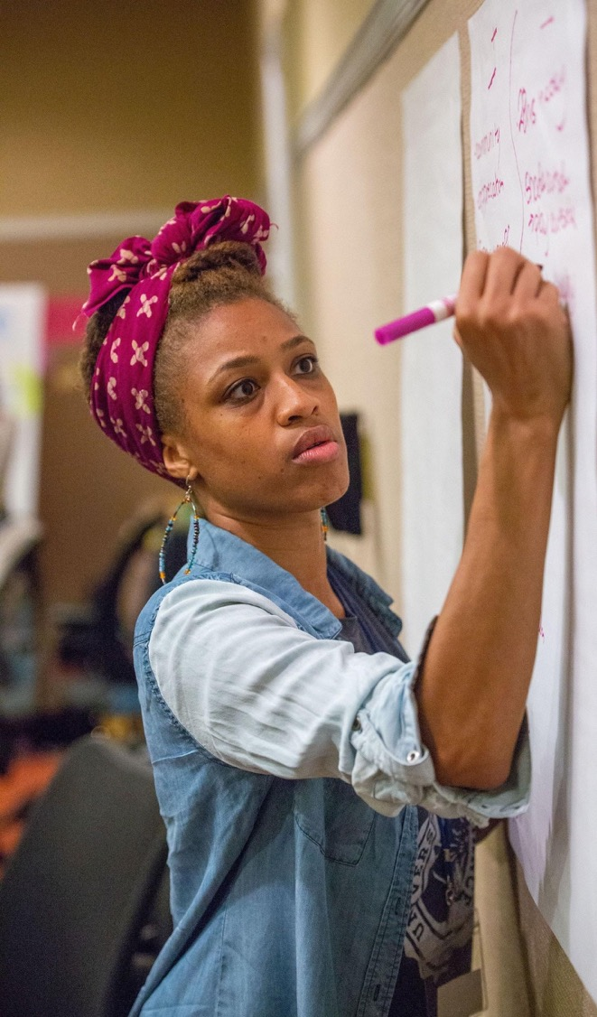
Learning Objectives
Ground in the principles of restorative justice (RJ)
Understand this restorative justice diversion (RJD) model in relation to the juvenile legal system
TEMPLATE // INTRODUCTION TO RESTORATIVE JUSTICE DIVERSION
BY THE RESTORATIVE JUSTICE PROJECT AT IMPACT JUSTICE // RJDTOOLKIT.ORG
Notes:
Read aloud.
There will be time for questions and answers at the end of the presentation, but feel free to let us know if you have any questions or need clarification at any time during the presentation as well.

Slide 5
PARADIGM SHIFT
We cannot solve our problems with the same thinking we used when we created them.
- Albert Einstein
TEMPLATE // INTRODUCTION TO RESTORATIVE JUSTICE DIVERSION
BY THE RESTORATIVE JUSTICE PROJECT AT IMPACT JUSTICE // RJDTOOLKIT.ORG
Notes:
Ask the audience:
How many of you have an iPhone? Especially an older iPhone?
Every so often how many of you get told you need to update your phone?
How many of you avoid updating as long as possible? Why do you avoid it? What happens if you avoid for too long?
Sometimes, we don’t update because the thought of learning a new OS makes us uncomfortable. It’s unfamiliar and we don’t want to deal with learning a new system.
What is the point of updating the iPhone?
Let’s be honest, sometimes these updates seem like they make the phone worse. Apple gets feedback on what isn’t working, and fix the glitches, come out with another update that makes the phone function better, based on real-time experiences
Additionally, these updates open doors to more creativity, innovation or help identify where things are working more quickly
What if we approached systemic change with the same level of innovation?
Our approach to harm and crime can also be updated to make sense of the times we live in, to address some of the negative results from having done things the same way for a while.
We know that we live in an era with mass incarceration, which costs an astronomical amount of money. It also has high rates of recidivism, and often people harmred feel like their needs aren’t being met. There are severe racial and ethnic disparities at every step of the process.
If we want to address these issues, we have to think innovatively, to use new logic and paradigms than the ones that led to these results.
Ask the audience:
What else comes to mind when you read this quote?
TIP: feel free to use your own example for this and/or instead of doing a call and response do this slide more in story mode using “I” statements, ie. “personally for me, change is hard. Every so often when my phone tells me to download new software meant to improve the operating systems, I don’t do it. I always think ‘ANOTHER update? Already?! I don’t need this. My phone works just fine and if I do it, there’s a chance that my phone may actually be slower or be glitchy and make everything worse.’ My first assumption is never that it could improve the way my phone weeks. And then, as time goes on, my phone starts getting slower, it starts telling me I can’t download something or open an email and in that moment, I’m like, “why!! Why didn’t I just update to this new operating system rather than trying to push through using something that wasn’t working!?’ …. etc.

Slide 6
Restorative Justice
Crime is a violation of people and interpersonal relationships.
Violations create obligations.
The central obligation is to, as much as possible, do right by the people you’ve harmed.
TEMPLATE // INTRODUCTION TO RESTORATIVE JUSTICE DIVERSION
BY THE RESTORATIVE JUSTICE PROJECT AT IMPACT JUSTICE // RJDTOOLKIT.ORG
Notes:
At its core, restorative justice is about relationships—how you create them, maintain them, mend them. It’s based on the philosophy that we are all interconnected, that we live in relationship with one another, and that our actions impact each other.
Grounded in the idea of interconnectedness, restorative justice is able to provide an alternative way of addressing wrongdoing or harm. Harm is seen as damaged relationship. You can see here how Howard Zehr, a professor at Eastern Mennonite University who wrote some of the first texts in the academic field of restorative justice, frames harm.
Read slide aloud.
We are in direct relationship with the people we harm—sometimes we know the person we harmed, sometimes we don’t and the relationship begins at the moment of harm. In recognizing that, Howard Zehr really calls us to a paradigm shift in how we look at and frame justice as a concern for healing or repairing harm directly to the person harmed as much as possible.

Slide 7
Current Criminal Legal Approach
What law was broken?
Who broke it?
How should they be punished?
TEMPLATE // INTRODUCTION TO RESTORATIVE JUSTICE DIVERSION
BY THE RESTORATIVE JUSTICE PROJECT AT IMPACT JUSTICE // RJDTOOLKIT.ORG
Notes:
When we think about how our current legal system responds to harm, we can break it down into three main questions (this is obviously an oversimplification, criminal lawyers ask many more questions, but these are some of the questions):
Read questions out loud.
Ask the audience: Who do these questions focus on?

Slide 8
Current Criminal Legal Approach
Restorative Justice Approach
What law was broken?
Who broke it?
How should they be punished?
Who has been harmed?
What do they need?
Whose obligation is it to meet those needs?
TEMPLATE // INTRODUCTION TO RESTORATIVE JUSTICE DIVERSION
BY THE RESTORATIVE JUSTICE PROJECT AT IMPACT JUSTICE // RJDTOOLKIT.ORG
Notes:
The paradigm shift that restorative justice calls us to is a very different set of questions:
Read the questions out loud.
Ask the audience: Who do these questions focus on?
Ask: Do you have any thoughts about this?
Reminder: It’s not necessarily a matter of which approach to justice is ‘better’ than the other, but the one that feels most natural to us as human beings, wanting to be in right relationship with each other.

Slide 9
Additional Restorative Justice Questions
Who has a stake in the situation?
What are the causes?
What is the appropriate process?
TEMPLATE // INTRODUCTION TO RESTORATIVE JUSTICE DIVERSION
BY THE RESTORATIVE JUSTICE PROJECT AT IMPACT JUSTICE // RJDTOOLKIT.ORG
Notes:
RJ also asks these questions.
Who has a stake in the offense?
Harm doesn’t just happen in a vacuum. We know that when harm happens it doesn’t just impact the person who was directly harmed and the person who did the harm, but it ripples out to loved ones, community members, who also have experienced worry, concern, and may even have trauma responses. There is space for all impacted people to talk about the impacts in RJ processes.
What are the causes?
The goal of RJ is to help repair harm AND to prevent future harm. We can’t address underlying causes without asking why the harm happened and without asking people what they need to heal/what they need to prevent future harm.
What is the appropriate process?
The right process honors all those who have a stake in the situation and acknowledges they have a stake. It considers their opinions and their thoughts. We will discuss all the choices the person harmed gets to make in terms of making the process fit their needs later in the presentation.

Slide 10
Insert picture here relevant to your personalized story.
TEMPLATE // INTRODUCTION TO RESTORATIVE JUSTICE DIVERSION
BY THE RESTORATIVE JUSTICE PROJECT AT IMPACT JUSTICE // RJDTOOLKIT.ORG
Notes:
RJ is what we thought justice was about when we were kids. When I was young and I broke a rule, I immediately felt bad. But when I learned that I’d get punished instead of having a chance to say sorry and make it up to the person, then I started to not feel bad about doing something wrong but instead feared getting caught and punished. It shifted my focus from what I did to being afraid of being punished.
Back in the days, folks did restorative justice without calling it that.
[Insert personal example of a time you caused harm and had to apologize and make it right to the person you harmed face-to-face]. See an example of this below:
EXAMPLE: Back in the days, folks did restorative justice without calling it that. For example, I stole a lipgloss when I was 10 years old. My mother found out—took me back to the store and made me go back to the store clerk, tell her what I did, and apologize to the clerk’s face. When the clerk opened the cap of the lipgloss, it was clear I’d already used it, and so my mother pulled out her wallet and paid for it. In the weeks that followed, I had to do extra work around the house to repay my mother. I understood the impact of what I’d done and never stole again— and clearly remembered this story like it was yesterday, even though it was 37 years ago! It is hard to look the person you harmed in the face and say what you did.

Slide 11
Family Group Conferencing (FGC) in Aotearoa, New Zealand
TEMPLATE // INTRODUCTION TO RESTORATIVE JUSTICE DIVERSION
BY THE RESTORATIVE JUSTICE PROJECT AT IMPACT JUSTICE // RJDTOOLKIT.ORG
Notes:
The Restorative Community Conferencing (RCC) process mainly used in existing restorative justice diversion programs comes from the Family Group Conferencing (FGC) model in Aotearoa (most commonly known as New Zealand)
Aotearoa is the Maori word for the land we now know as New Zealand
The Maori people are the indigenous people of Aotearoa
In 1988, New Zealand’s government commissioned a report identifying government practices that resulted in a disproportionate number of Maori youth being incarcerated. The government took feedback from folks and began using a Maori inspired restorative process, called Family Group Conferencing, to address youthful wrongdoing. In 1989 The Children, Young Persons, and Their Families Act made Family Group Conferencing the primary way of dealing with harms by children, except for murder and manslaughter
Implementing FGC drastically reduced their youth incarceration rates
This was intended to both reduce incarceration and reduce racial and ethnic (RED) disparities BUT what they learned after decades of implementation is that RED persists, unless RED reduction is intentionally focused on in the beginning and revisited throughout, all while collecting and checking the data the entire time
For more information and background on this topic, on this please see report: New Zealand’s Youth Justice Transformation: Lessons for the United States by the National Juvenile Justice Network.

Slide 12
What is Restorative Community Conferencing (RCC)?
Opportunity for face to face dialogue
Involves only the folks impacted by the harm
Orients around needs of person harmed
Responsible youth takes steps to repair the harm
TEMPLATE // INTRODUCTION TO RESTORATIVE JUSTICE DIVERSION
BY THE RESTORATIVE JUSTICE PROJECT AT IMPACT JUSTICE // RJDTOOLKIT.ORG
Notes:
A Restorative Community Conference is a secular adaptation of Family Group Conferencing and is a face-to-face dialogue between the person harmed & their supporters, the responsible youth & their supporters, and community. It is led by a trained facilitator and is a process of accountability that seeks to identify, repair, and prevent harm.
Ask:
How many of us have hurt someone?
How many of us were not able to talk to that person about how we harmed them?
Think to yourselves about what you could say if you could have? Looking back, how does it feel that you didn’t get to say something? [Ask for out loud responses to this question]
How many of us can think of a time when we hurt someone and we did get to have that conversation? Was it easy? [Ask for responses] What was hard about it? [Ask for responses]
Ask:
Now think of a time someone harmed you. When you didn’t get an apology or a conversation how did that feel? Did you still have questions or needs?
The process is totally voluntary for the person harmed—they decide if they want to participate. They can change their mind at any time—even the day of the conference.
In this process, the person harmed discusses how they were harmed and what they need. They ask the young person all the questions they have about the situation and talk not just about the event, but all the ways it impacted them.
The young person, with the help of their supporters, comes up with a 4 Part Plan to Repair the Harm: 1) Repair the harm to the person harmed; 2) Repair the harm to the community; 3) Repair the harm to the young person themselves; 4) Repair the harm to the young person’s family
All folks present come to consensus about the plan. Then a facilitator monitors the plan completion.

Slide 13
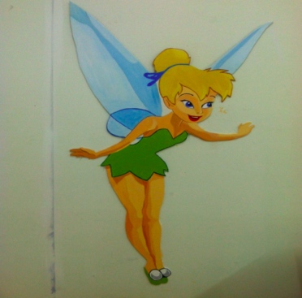
What do people harmed want?
TEMPLATE // INTRODUCTION TO RESTORATIVE JUSTICE DIVERSION
BY THE RESTORATIVE JUSTICE PROJECT AT IMPACT JUSTICE // RJDTOOLKIT.ORG
Notes:
There is a video link attached to the Tinkerbell image. Click the image to play the video.
The video is a 5 minute clip of sujatha baliga (one of the founders of the Alameda County RJD program, the nation’s longest running RJD program) recounting a story of one of the RJD cases she facilitated that can help provide more tangible context to this process.
Feel free to use this link or insert your own story or stories of repairing harm instead.
NOTE: a note on language. You may have noticed that we oscillate between using terms like “person harmed,” and “survivor,” “responsible party,” etc. and avoid language like “perpetrator” and “offender.” It’s important for us that we stay away from the victim/perpetrator binary. We feel these labels fix people in time and don’t allow for a fluidity of identities (someone can cause harm and also be a survivor of harm), or allow space for a healing journey/transformation to occur. In using language like person harmed and responsible party, we are able to refer to a specific experience/interaction/behavior and acknowledge what has been done, without boxing anyone into an identity or having the focus of your identity be from one specific experience.

Slide 14
Core Elements of this RJD Model
The RJD program is…
Oriented around the needs of people harmed
Designed to end racial & ethnic disparities (RED) in juvenile and criminal legal systems
Focused exclusively on pre-charge diversion
Structured to prevent net-widening in the juvenile legal system
Dedicated to a strengths-based approach to healing harm
Rooted in relationships - how to nourish, deepen, and heal them
Committed to protecting participant confidentiality
TEMPLATE // INTRODUCTION TO RESTORATIVE JUSTICE DIVERSION
BY THE RESTORATIVE JUSTICE PROJECT AT IMPACT JUSTICE // RJDTOOLKIT.ORG
Notes:
These are the core elements of this model of RJD that have been developed based on best practices from jurisdictions across the country using this same model. These may be different than other descriptions of restorative justice you may have heard about or participated in. We have adopted these elements based on experiential learnings and international research on best practices for this model of RJD.
Oriented around the needs of people harmed
The person harmed identifies what they need to repair the harm. The process is oriented around getting these needs met and their questions answered. They also get to decide things that would make them feel safe and supported in the process—including details like who sits where, who enters the room first, who they want there as support people, etc.
Designed to end racial & ethnic disparities (RED) in juvenile and criminal legal systems
Keeping ending RED at the forefront of how we implement RJD programs is essential.
To do this, jurisdictions have picked the zip codes from which children of color are most often incarcerated or crimes for which youth of color are disproportionately incarcerated.
Without doing this, discretion always results in discrimination.
Focused exclusively on pre-charge diversion
The young person has been arrested but not yet charged with the crime when their case is referred to the RJD program. The DA or Probation refers the case to RJ without taking any action. This means that the case is on a hold, and they won’t do anything unless the case is returned to them.
Why do this?
Probation violations are one of the leading causes of a youth being incarcerated.
Apologizing in the criminal legal system is an admission of guilt and is something to be afraid of doing because it will result in punishment.
It is hard to ask a young person to tell the truth for RJ and not fear criminal consequences after they have been in the system.
CBO will be in the position to give legal advice that they aren’t qualified to give if they aren’t criminal defense lawyers or immigration lawyers, or child welfare lawyers.
This could also cause liability issues.
Structured to prevent net-widening in the juvenile legal system
The cases diverted to RJD should only be cases that would have been charged and would have resulted in the young person being incarcerated or placed on probation. The purpose of this is to both support people harmed and reduce incarceration—not to divert cases that would have been diverted anyways or low level cases that wouldn’t have resulted in probation/incarceration.
Dedicated to a strengths-based approach to healing harm
When working with responsible youth, shift the approach from “what is ‘wrong’ with them to what is right with them
Do the same with people harmed. Find out what is important to them and what they know helps them heal
Rooted in relationships - how to nourish, deepen, and heal them
Relationship building (and how you go about it) creates trust and security. Kay Pranis developed her restorative justice circle processes trainings from what she learned from various First Nations’ people and the concept of the Medicine Wheel. While the lessons from Medicine Wheels can apply to many different contexts, according to Kay, “Before trying to work out issues or move to action, the Circle Process must first spend time helping participants connect as human beings.” Therefore, the first two quadrants of the wheel (the entire first half of the process!) are devoted entirely to building relationship:
Meeting, Getting Acquainted
Building Understanding & Trust
Addressing Vision/Issues (Content)
Developing Plans/Sense of Unity
We can approach RCCs the same way. These four stages will exist at the conference itself, but will also begin in prep. Especially in prep, getting to know each other and building understanding and trust should be prioritized. We want to know what folks value, what they like about themselves, what they’re interested in, what they want out of this process, what would make them feel whole, what will help them feel their dignity is intact or increased during this process.
Committed to protecting participant confidentiality
In all jurisdictions, the DA signs a memorandum of understanding that says anything discussed in prep, the process, and follow up is confidential and won’t be used to prosecute the young person. Otherwise, folks in RJD won’t tell the truth for fear that it will be used against them in court.

Slide 15
These are the Kinds of Harms RJD is good for:
Burglaries
Assault/Batteries
Vehicle Theft
Grand Theft/Theft of Person
Robberies
Arson
Theft
And, many more
TEMPLATE // INTRODUCTION TO RESTORATIVE JUSTICE DIVERSION
BY THE RESTORATIVE JUSTICE PROJECT AT IMPACT JUSTICE // RJDTOOLKIT.ORG
Notes:
This process is most effective for high-level misdemeanors and low-level felonies that have actual and identifiable crime people harmed
Cases with direct people harmed are ideal for restorative justice because the young person has to be able to connect what they did to the emotional impact on the person harmed. Young folks understand that getting a house broken into scares the people inside or that getting a car stolen is scary for folks and feels very personal.
Note: While the cases listed above are good for RJD, you will use county arrest and incarceration data to identify the cases most suitable for the program in your county.
International research shows that RJ processes can reduce post-traumatic stress symptoms among people harmed, including anxiety and fear. 2 of the most significant things they found is that person harmed needs to know, “Why me.” And that getting this question answered reduces their post-traumatic stress symptoms. One reason is because they often blame themselves for the crime. “If I hadn’t parked my car there; if I just stayed home from the party like I wanted to; if I hadn’t been walking that late at night.” Getting the person who harmed them to answer questions about why they did it helps reduce this self-blame. And reducing this self-blame actually reduces their post-traumatic stress symptoms.

Slide 16
Restorative Justice Diversion Works!
Recidivism
Annual Cost Per Young Person
40
$500k
$493k
30
32.1%
$333k
20
18.4%
$166k
10
$10k
0
$0
Alameda County RJD Program
Alameda County
Juvenile Legal System
TEMPLATE // INTRODUCTION TO RESTORATIVE JUSTICE DIVERSION
BY THE RESTORATIVE JUSTICE PROJECT AT IMPACT JUSTICE // RJDTOOLKIT.ORG
Notes:
​The recidivism data ​are ​from ​an evaluation of ​the Alameda County RJD program, the oldest RJD program in California​. The report can be found on the Impact Justice website: https://impactjustice.org/wp-content/uploads/CWW_RJreport.pdf.​
Recidivism ​12 months out for kids that completed the program was 18.4% for young folks that went through the juvenile legal system for the same types of cases it was 32.1%​. ​Recidivism in the study was defined as the likelihood that a young person​ ​will be arrested ​AND subsequently adjudicated delinquent (i.e. found guilty by a judge).
In 2010, Alameda County’s RJD program carried a one-time cost of approximately $4,500 per case. Today, Impact Justice’s RJ Project estimates that RJD program costs may up to approximately $10,000 per child in the implementation phase, reducing to approximately $7,000 at scale. It costs over $490,000 per year to incarcerate a young person in Alameda County. Given that youth are rarely involved in the juvenile justice system for just one year, the cost savings of an RJD program are tremendous.
NOTE: The cost per RJD case was calculated by the total budget that​ facilitating community-based organization​ ​(​Community Works​ West​) had for the ​RJD program divided by the number of youth they served on an annual basis. The source for the ​cost per ​Alameda County ​j​uvenile ​l​egal ​s​ystem ​youth ​is from a 2019 report ​(Vanishing Violence) ​by the San Francisco Chronicle, ​which can be ​found ​on their website: https://projects.sfchronicle.com/2019/vanishing-violence/part-2/
TIP: See if you can find the cost of incarcerating a young person in your county for one year and use that number here to capture an even more relevant picture of what cost savings could look like in your county!

Slide 17
Satisfaction Among People Harmed
91%
91%
would participate in another conference
would recommend the process to a friend
TEMPLATE // INTRODUCTION TO RESTORATIVE JUSTICE DIVERSION
BY THE RESTORATIVE JUSTICE PROJECT AT IMPACT JUSTICE // MOVESLIKEWATER.ORG
Notes:
Again, this data was collected from the Alameda County RJD program. After each conference (face-to-face dialogues), facilitators gave out evaluations to every participant. Those surveys measured a variety of outcomes, including satisfaction among people harmed. The data shows a 91% satisfaction rate among people harmed, as measured above.

Slide 18
Justice is what love looks like in public.
- Dr. Cornell West
TEMPLATE // INTRODUCTION TO RESTORATIVE JUSTICE DIVERSION
BY THE RESTORATIVE JUSTICE PROJECT AT IMPACT JUSTICE // RJDTOOLKIT.ORG

Slide 19
Questions?
TEMPLATE // INTRODUCTION TO RESTORATIVE JUSTICE DIVERSION
BY THE RESTORATIVE JUSTICE PROJECT AT IMPACT JUSTICE // RJDTOOLKIT.ORG

